Slide 1
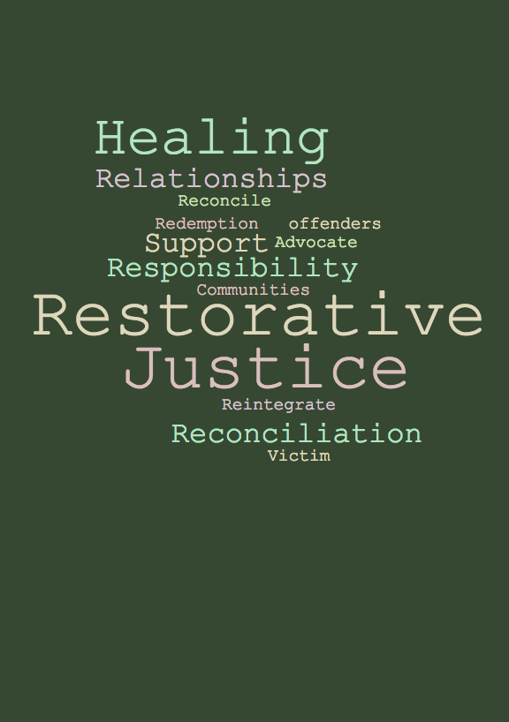
An Introduction to Restorative Practices with PBIS:
Day 2
Lori Lynass Ed.D.
Bridget Walker, Ph.D.
www.soundsupportsk12.com

Slide 2
OBJECTIVES
Understand core principles of restorative practices and how they differ from traditional punitive approaches.
Understand PBIS and restorative practices alignment.
Be able to lead circle dialogues.
Learn the restorative questions and how to use them.
Understand affective language statements.

Slide 3

THE CIRCLE: Opening Circle
Notes:
What resonated with you most about yesterday?
Use blank cards or sticky notes: have people write down their finest quality they are brining to the circle today.
What are you hoping for today?

Slide 4
VIDEO: Creating a Paradigm Shift
https://www.youtube.com/watch?v=5r1yvyP141U&t=230s

Slide 5
PARADIGM SHIFT
Traditional Discipline | Restorative Practices
School and rules violated
Justice focuses on establishing guilt
Accountability = punishment
Justice directed at offender, while victim is ignored
Rules and intent outweigh whether outcome is positive/negative
No opportunity for remorse or amends
Notes:
Do the first one together and then as a table group have them do the rest and debrief.

Slide 6
PARADIGM SHIFT
Traditional Discipline | Restorative Practices
School and rules violated | People and relationships violated
Justice focuses on establishing guilt
Accountability = punishment
Justice directed at offender, while victim is ignored
Rules and intent outweigh whether outcome is positive/negative
No opportunity for remorse or amends
Notes:
Do the first one together and then as a table group have them do the rest and debrief.

Slide 7
PARADIGM SHIFT
Traditional Discipline | Restorative Practices
School and rules violated | People and relationships violated
Justice focuses on establishing guilt | Justice identifies needs and obligations
Accountability = punishment
Justice directed at offender, while victim is ignored
Rules and intent outweigh whether outcome is positive/negative
No opportunity for remorse or amends
Notes:
Do the first one together and then as a table group have them do the rest and debrief.

Slide 8
PARADIGM SHIFT
Traditional Discipline | Restorative Practices
School and rules violated | People and relationships violated
Justice focuses on establishing guilt | Justice identifies needs and obligations
Accountability = punishment | Accountability = understanding impact, repairing harm
Justice directed at offender, while victim is ignored
Rules and intent outweigh whether outcome is positive/negative
No opportunity for remorse or amends
Notes:
Do the first one together and then as a table group have them do the rest and debrief.

Slide 9
PARADIGM SHIFT
Traditional Discipline | Restorative Practices
School and rules violated | People and relationships violated
Justice focuses on establishing guilt | Justice identifies needs and obligations
Accountability = punishment | Accountability = understanding impact, repairing harm
Justice directed at offender, while victim is ignored | Offender, victim and school all have direct roles in justice process
Rules and intent outweigh whether outcome is positive/negative
No opportunity for remorse or amends
Notes:
Do the first one together and then as a table group have them do the rest and debrief.

Slide 10
PARADIGM SHIFT
Traditional Discipline | Restorative Practices
School and rules violated | People and relationships violated
Justice focuses on establishing guilt | Justice identifies needs and obligations
Accountability = punishment | Accountability = understanding impact, repairing harm
Justice directed at offender, while victim is ignored | Offender, victim and school all have direct roles in justice process
Rules and intent outweigh whether outcome is positive/negative | Offender is responsible for harmful behavior, repairing harm and working toward positive outcome
No opportunity for remorse or amends
Notes:
Do the first one together and then as a table group have them do the rest and debrief.

Slide 11
PARADIGM SHIFT
Traditional Discipline | Restorative Practices
School and rules violated | People and relationships violated
Justice focuses on establishing guilt | Justice identifies needs and obligations
Accountability = punishment | Accountability = understanding impact, repairing harm
Justice directed at offender, while victim is ignored | Offender, victim and school all have direct roles in justice process
Rules and intent outweigh whether outcome is positive/negative | Offender is responsible for harmful behavior, repairing harm and working toward positive outcome
No opportunity for remorse or amends | Opportunity given for amends and expression of remorse
Notes:
Do the first one together and then as a table group have them do the rest and debrief.

Slide 12
RESTORATIVE PRACTICES: Continuum
Small impromptu conference
Group or Circle
Affective Statements
Affective Questions
Formal Conference
1
2
3
4
5
INFORMAL
FORMAL
This is also thought of as a Restorative Chat.
The Restorative Practices Handbook by Bob Costello, Joshua Wachtel and Ted Watchtel

Slide 13
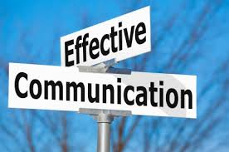
RESTORATIVE PRACTICES: Affective language
  An authentic expression of feelings and impact in relation to an action (positive or negative)
  Building strengthened relationships by genuinely presenting oneself as someone who cares and has feelings.
  Adapted from Berkowitz, K., 2015

Slide 14
Sample student Response plan
Non-verbal Signal, Proximity, Praise desired Behaviors
Offer Support and/or Choices
Reset, break and/or Affective wise Feedback (Restorative Chat)
Buddy classroom with restorative sheet
Short impromptu conference
Formal conference

Slide 15
RESTORATIVE PRACTICES: Constructing an Affective Wise Feedback Statement
Step 1 – Setting Expectations
Step 2 – Giving Clear Feedback
Step 3 – Reconnecting/Restoring
Step 4 – Invitation

Slide 16
RESTORATIVE PRACTICES: Affective Statements
Typical Response | Affective Response
Stop teasing Sandy.
Notes:
Do the first one together and then as a table group they do the rest.

Slide 17
RESTORATIVE PRACTICES: Constructing an Affective Wise Feedback Statement
Step 1 – Setting Expectations
Why are you giving the student feedback (i.e Setting the tone)?
  I am giving you some feedback about your (name behavior) because (barrier).
  I am giving you some feedback about (named behavior) so that we can (blank goal).
  I want to talk to you about (appropriate behavior), so that (blank goal)

Slide 18
RESTORATIVE PRACTICES: Affective Statements
Typical Response | Affective Response
Stop teasing Sandy. | 1. I’m giving you feedback because the way you are treating Sandy is not showing respect which our class value.
Notes:
You want students understand the impact of their behaviors on others.

Slide 19
RESTORATIVE PRACTICES: Constructing an Affective Wise Feedback Statement
Step 2 – Giving clear feedback
“Name and Frame”
Specific Feedback about Behavior
I don’t know your intent. However, your behavior has (impact) on (who/what).

Slide 20
RESTORATIVE PRACTICES: Affective Statements
Typical Response | Affective Response
Stop teasing Sandy. | 1. I’m giving you feedback because the way you are treating Sandy is not showing respect which our class value. 2. I don’t know your intent, but your actions are hurting Sandy.
Notes:
You want students understand the impact of their behaviors on others.

Slide 21
RESTORATIVE PRACTICES: Constructing an Affective Wise Feedback Statement
Step 3 – Reconnecting/Restoring
Statement of encouragement/belief in student abilities and/or skills
  You are (affirming character) and I believe you can (blank) in our classroom.
  I have noticed (positive attributes) and believe you will (blank) moving forward.

Slide 22
RESTORATIVE PRACTICES: Affective Statements
Typical Response | Affective Response
Stop teasing Sandy. | 1. I’m giving you feedback because the way you are treating Sandy is not showing respect which our class value. 2. I don’t know your intent, but your actions are hurting Sandy. 3. I have seen you show respect to your classmates and know that you can with Sandy.
Notes:
You want students understand the impact of their behaviors on others.

Slide 23
RESTORATIVE PRACTICES: Constructing an Affective Wise Feedback Statement
Step 4 – Invitation
Ask an open-ended question:
Tell me something I might be missing?
How can we better work together?
How would you like me to acknowledge you?
Reminder Listen with empathy…“I hear, notice, sense, feel”

Slide 24
RESTORATIVE PRACTICES: Affective Statements
Typical Response | Affective Response
Stop teasing Sandy. | 1. I’m giving you feedback because the way you are treating Sandy is not showing respect which our class value. 2. I don’t know your intent, but your actions are hurting Sandy. 3. I have seen you show respect to your classmates and know that you can with Sandy. 4. Is there something else I should know about what’s going on?
Talking during class is inappropriate
Notes:
You want students understand the impact of their behaviors on others.

Slide 25
RESTORATIVE PRACTICES: Affective Statements
Typical Response | Affective Response
Stop teasing Sandy.
Talking during class is inappropriate
Notes:
Do the first one together and then as a table group they do the rest.

Slide 26
RESTORATIVE PRACTICES: Affective Statements
Typical Response | Affective Response
Talking during class is inappropriate | I’m giving you feedback because when you are talking while I am trying to teach, I feel very frustrated. I don’t know your intent, but your actions are preventing our class from learning well together. I have seen you raise your hand when you have a comment or question and know that you can follow this class agreement. Is there something I should know about this situation?
Notes:
Have them think of a few on their own at their tables.

Slide 27
RESTORATIVE PRACTICES: Continuum
Small impromptu conference
Group or Circle
Affective Statements
Affective Questions
Formal Conference
1
2
3
4
5
INFORMAL
FORMAL
The Restorative Practices Handbook by Bob Costello, Joshua Wachtel and Ted Watchtel

Slide 28
Restorative Practice Questions
What happened?
What were you thinking about at the time?
What have you thought about since the incident?
Who has been affected by what happened and how?
What about this has been the hardest for you?
What do you think needs to be done to make things right?

Slide 29
PRE-CIRCLE:
Purpose:
Prepare a student to come into the restorative circle process and assess if the student is ready and willing to participate in the larger restorative circle.

Slide 30
PRE-CIRCLE: Questions for Restorative Practice
What happened?
What were you thinking about at the time?
What have you thought about since the incident?
Who has been affected by what happened and how?
What about this has been the hardest for you?
What do you think needs to be done to make things right?
What are your strengths that you would bring to a harm circle to resolve the issue?
Are you willing to come to the harm circle to resolve the issue?

Slide 31
PRE-CIRCLE: Opening 1
Welcome the student
Mindful Moment
Introduce the talking piece ( if using) and circle agreements.
“Our goal is to understand how you and others have been impacted by the incident and what needs to be done to repair the harm. I want to thank you for your willingness to be part of this process.”

Slide 32

PRE-CIRCLE: Opening 2
Proceed with the RJ questions and use active listening.
questions by Gregor Cresnar from the Noun Project

Slide 33
PRE-CIRCLE: Closing Rounds
What are your strengths that you would bring to a harm circle to resolve the issue?
Are you willing to come to the harm circle to resolve the issue?
Thank them for participating.
* Follow the Script

Slide 34

Triads & Small Circle Practice
Notes:
Use the cards with elementary and secondary scenarios.

Slide 35
VIDEO: Addressing Harm/Responsive Circles
https://www.youtube.com/watch?v=g8_94O4ExSA&t=5s
https://www.youtube.com/watch?v=Htx9SmBYWZQ

Slide 36
HARM CIRCLE
Purpose:
To discuss what happened from their perspective and to come to a resolution for how to repair the harm done. Remind the students to speak their truth only.

Slide 37
Opening Rounds for Harm Circle
1. Welcome the participants.
2. Choose a centering activity:
Encourage them to take a mindful moment or 3 deep breaths.
Have students write down a trait/value they are bringing into the circle and committing to. On opening round, have students state the trait/value and place it into the circle.
3. State the purpose.

Slide 38
HARM CIRCLE: Opening Round Purpose
“We are in this circle to work out how to make things right after the incident (name the incident/conflict). Our goal is to understand how you and others have been impacted and how we can repair the harm. I want to thank you for your willingness to be part of this process.”

Slide 39
HARM CIRCLE
Review the Circle Guidelines and introduce the talking piece.
Use the RJ questions on the card with Active Listening

Slide 40
Closing Rounds of Harm Circle
Thank the students for their participation.
Review agreements.
Send talking piece around once more for any final statements the students feel need to be said.

Slide 41
Circle Practice
The Class That Ate the Sub

Slide 42
CIRCLE PRACTICE: The Class That Ate the Sub
Facilitator: Guide the circle participants to a fair solution to the problem.
Regular Teacher
Student 1: Was throwing paper airplanes across the room.
Student 2 : Continually Out of Seat, Even after three prompts.
Student 3: Refusing to do work, talking back to the sub and being rude.

Slide 43
Harm Circles: Debrief
Notes:
Do a round for each participant category from role play

Slide 44
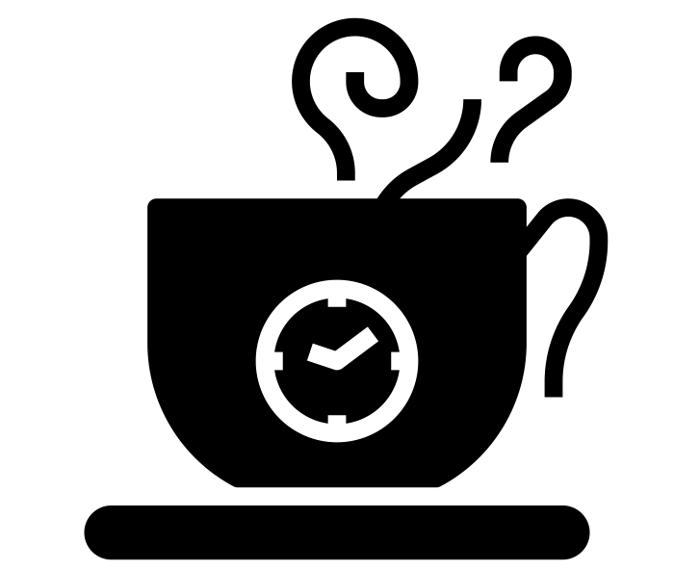
coffee break by dDara from the Noun Project

Slide 45
Integrating Practices
PBIS and Restorative Justice

Slide 46
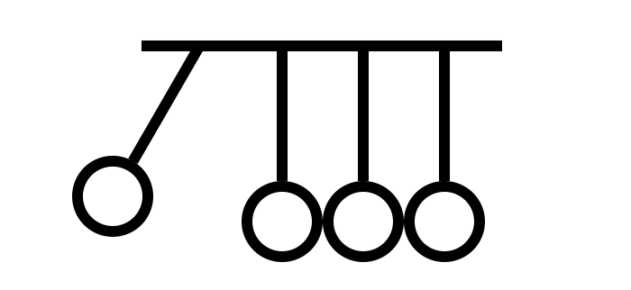
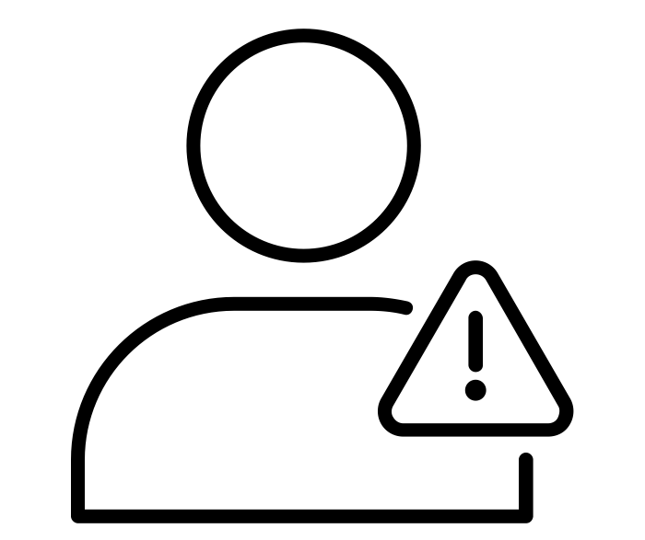
THE INTERSECTION OF PBIS AND RJP:
Philosophical Alignment
  PBIS & Restorative Practices are responses to Zero Tolerance
  Approaches to preventing, reducing and responding to problem behavior
Lucille Eber, 2015
reaction by Nicolas Mitchell from the Noun Project
user error by Chaitanya Krishna from the Noun Project

Slide 47
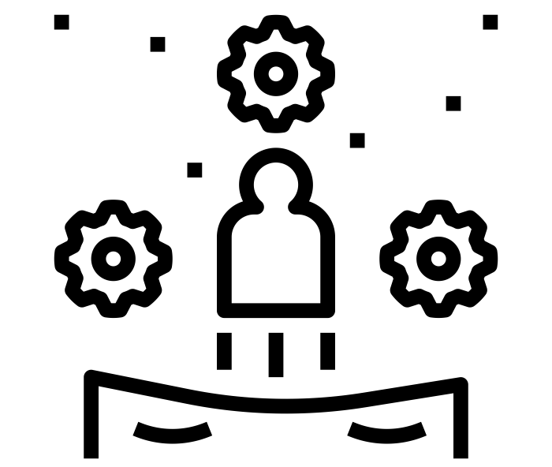
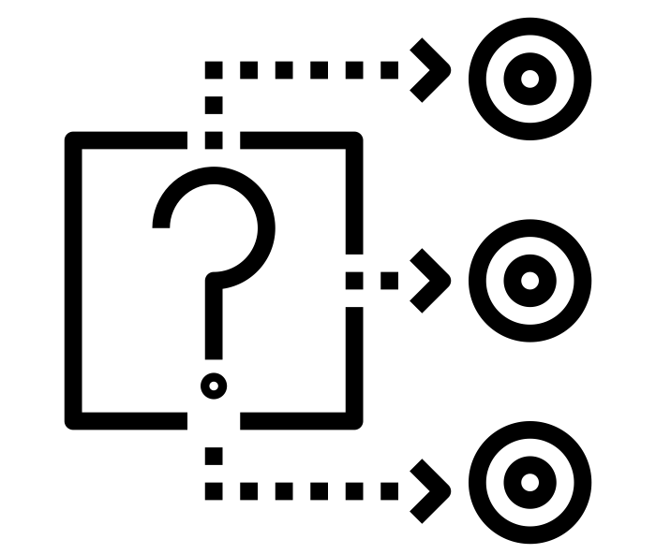
THE INTERSECTION OF PBIS AND RJP: Alternatives to Discipline
  PBIS provides systems to guide
  adult behaviors
  RP provides a range of alternatives behaviors for adults to engage in that are not exclusionary reactions to behavior
Lucille Eber, 2015
behavior by Nithinan Tatah from the Noun Project
cause by Nithinan Tatah from the Noun Project

Slide 48

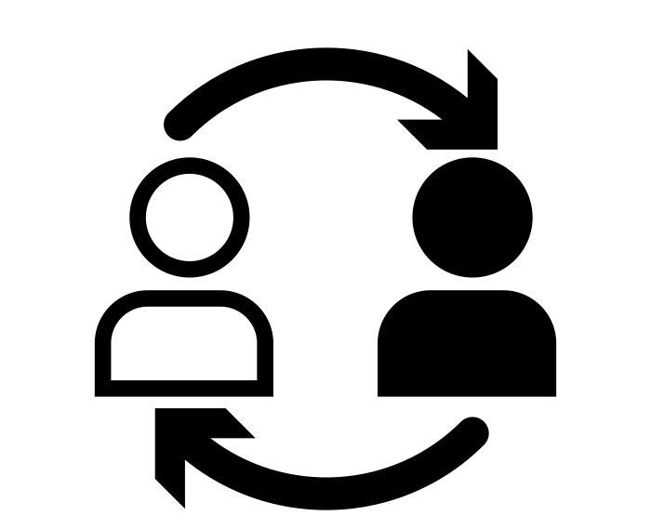

THE INTERSECTION OF PBIS AND RJP:
Reshaping Discipline
  Commonly agreed upon standards
  of conduct of adults and youth
  Ensure positive relationships
  (students/staff)
  Whole school and sense of
  community-Positive climate
  Maintain student dignity
Lucille Eber, 2015
rules by jngll from the Noun Project
relationship by Chanut is Industries from the Noun Project
Community by Maxim Kulikov from the Noun Projec

Slide 49
A CONTINUUM OF RESTORATIVE PRACTICES
A CONTINUUM OF SWPBIS PRACTICES
Intensive Intervention
Return from suspension
Administrative transfer or school crime diversion:
Victim offender meetings
Family/community group conferences
Restitution
Intensive Intervention
Function-based support
Wraparound support
~5%
~15%
Early Intervention
Alternatives to suspension:
Youth/peer court
Peer mediation
Conflict resolution training
Restitution
Early Intervention
Check-in/ Check-out
Social Skills Curricula
Prevention & Skill Building
Define and teach expectations
Establish consequence system
Collection and use of data
Prevention & Skill Building
Peace-keeping circles for:
Morning meetings
Social/emotional instruction
Staff meetings
~80% of Students
Notes:
Make the connection that Tier 1 RJ and PBIS is about working with students, creating expectations/agreements with students not to or for students.

Slide 50
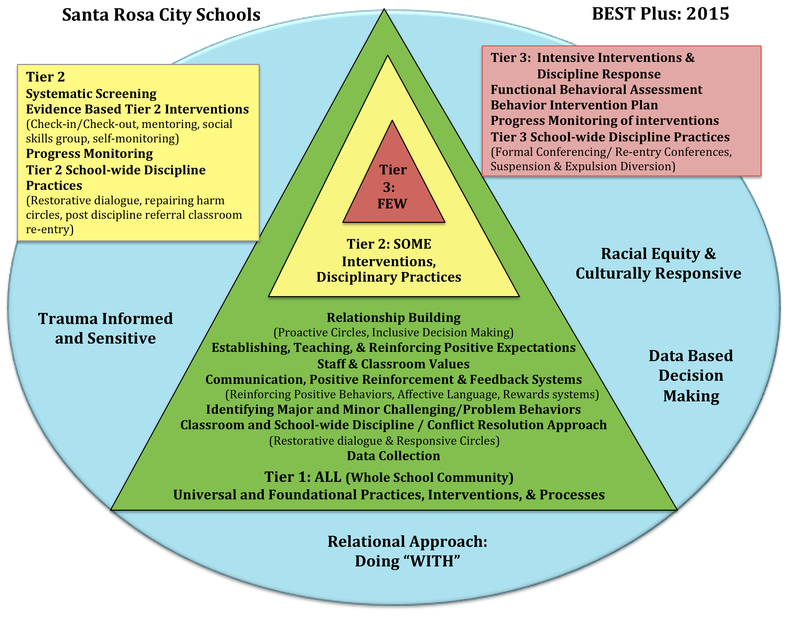

Slide 51
Establishing, Teaching & Reinforcing School-wide Behavior Values and Expectations
SAFE * RESPECTFUL * RESPONSIBLE +
DEFINING expected behaviors FOR THE CLASSROOM
Teaching and internalizing desired behaviors
Input on Behavior matrices
Define behaviors in positive terms

Slide 52
Behavioral Intervention Documentation & Requesting Additional Support: Office Referrals
Level | Description | Documentation | SWIS Data Input | Student Placement
1a | Minor behavior that teacher/staff handles in the classroom. | Classroom behavior Log | No | Student remains class.
1b | Minor behavior that persists after approx. 3 intervention attempts by teacher/staff and teacher/staff wants for the behaviors to be documented in the SWIS system. | Office Referral Form & Parent Contact | Yes, documented as a minor behavior in SWIS system. | Student remains in class.
2 | Student’s behavior significantly impacts the classroom-learning environment and/or is a minor behavior that continues to persist after approx. 5 intervention attempts by the teacher/staff. | Office Referral Form & Parent Contact | Yes, documented as a major behavior in SWIS system. | Student may be requested to leave the class. * Restorative suggested
3 | Student’s behavior seriously jeopardizes classroom or school safety and order. | Office Referral Form & Parent Contact | Yes, documented as a major behavior in SWIS system. | Student is removed from class. *Restorative re-entry required
4 | Behavior presents an imminent threat of serious harm to the school community, or when the student’s behavior seriously affects the safety of others in the school and/ or educational process. | Office Referral Frm & Parent Contact | Yes, documented as a major behavior in SWIS system. | Student is removed from class and school. * Restorative Process required

Slide 53
Reduction in Suspensions Across Five Years

Slide 54
IN PRACTICE: Rainer Beach: Beautiful! -- 2.0
Community-Wide Restorative Justice
School- Wide Restorative Justice
School- Wide PBIS
Community- Wide PBIS
INTENSIVE INTERVENTIONS
Case Management Therapeutic Services
Policy Changes
Physical Environment Changes
Community re-entry circles
Wraparound supports
Tier 3
5%
Tier 2
15%
Tier 1
80% of individuals
INTENSIVE INTERVENTIONS
School re-entry circles
Wraparound supports
EARLY INTERVENTIONS
EARLY INTERVENTIONS
Small Group Reinforcement
Social Emotional Learning (SEL)
Restorative Circles
Peer Mediation
Restitution
Restorative Circles
Peer Mediation
Restitution
Restorative Circles
Peer Mediation
Restitution
PREVENTION AND SKILL BUILDING
PREVENTION AND SKILL BUILDING
Peace Circles for community meetings
Train community peer mediators
Peace Circles for classroom meetings and staff meetings
Train student peer mediators
Establish Common Behavior Expectations
Model, Train, Reward Positive Behaviors
Establish Common Behavior Expectations
Model, Train, Reward Positive Behaviors

Slide 55
RBHS PBIS/RJ Tiered Interventions & Supports
Tier 1 Schoolwide
Tier 2 Team (2017-18)
DRAFT Tier 3 Individualized
(2018-19)
Beach 5 Expectations & PBIS Classroom (4+/1-), 80% meet standards
Classroom Interventions: check-in, reminder, reflection sheet, 1 on 1, hall talk, seat change, contract, teacher detention, restorative circle
Recognitions & Drawings
Referral to 104, Reflection Sheet, Calls Home
Grade level team interventions, calls & monitoring (interventions monitored @ 3-4 weeks: try 2-3 then Tier 1.5)
Required Homework Center
Socio-emotional Screenings
Team & Small Group Supports; AIS Check & Expect
Check & Connect Mentors
Daily Check-in-Checkout (CiCo)
Advisory Period Intervention Class: Study skills, self-monitoring, conflict resolution, problem solving circles, engagement, motivation
Drug/Alcohol Assessment
Functional Behavior Assessment /Behavior Intervention Plan (BIP)
Clear entry, progress monitoring & exit criteria
Individualized problem solving and conflict circles
Individualized Plan (testing & IEP)
Counseling, nurse interventions
Housing or Food Support
Extensive Behavior Intervention Plan (BIP)
Crisis Intervention Team (Suicide)
SIT Referral Form
Tier 1.5 Teacher initiated Family Circle/Meeting (Contract)
Tier 2.5 (Truancy/SIT) Meeting/
Family/Home Visit
A = Attendance
>3 Unexcused Days Absent, > 3 Unserved Tardies
>7 Unexcused Days Absent
B = Behavior
3 times in 104, refusal of 104 process; office level referral (Contact Office or 104 staff)
Non-responders to Tier 2 interventions (6 weeks); 2 major office level referrals
C = Course Performance
Continuing on the D/E list despite phone call and supports (2 Intervention Nights)
Failing core classes despite interventions (See GPA & Credit chart)

Slide 56
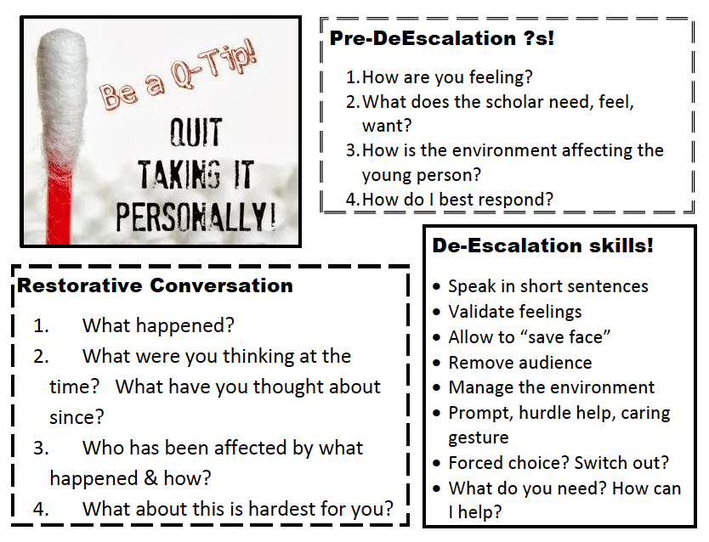
Restorative Conversation
What happened?
What were you thinking at the time? What have you thought about since?
Who has been affected by what happened & how?
What about this is hardest for you?

Slide 57
Big Ideas Across Tiers
Systems – Support adult behavior
  Handbooks
  Policy
  Calendar of events
  Data collection and summary system
Data – Support decision making
  Identification
  Fidelity
  Outcomes
Practices – Support student behavior
  Teaching rules and expectations
  Acknowledge desired behaviors
  Respond consistently to problem behaviors
  Monitor data
Systems
Practices
Data
Outcomes

Slide 58
Closing Circle
Notes:
First Round: What are you feeling now?
Second Round: I used to think, now I think.

Slide 59
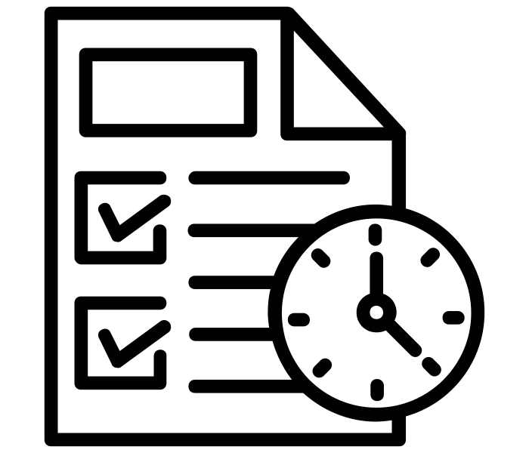
Planning Time
How will you go back and create the “why” with staff?
What next steps need to occur to be able to take this work back to other staff?
How can you personally begin to use this in your setting?
Time planning by Vectors Market from the Noun Project

Slide 60
Thank You For Attending!
Lori Lynass - lynassl@gmail.com
Bridget Walker - bridgetwalkerphd@gmail.com
Carol Frodge – cnfrodge@gmail.com
www.soundsupportsk12.com

